Slide 1
Boston Crime Analysis ALY6015 – Intermediate Analytics
Group Members
Manoznasai Koduri
Harsha Vardhan Kasireddy
Manikandan Meenakshi Sundaram
Professor: Zhi He

Slide 2
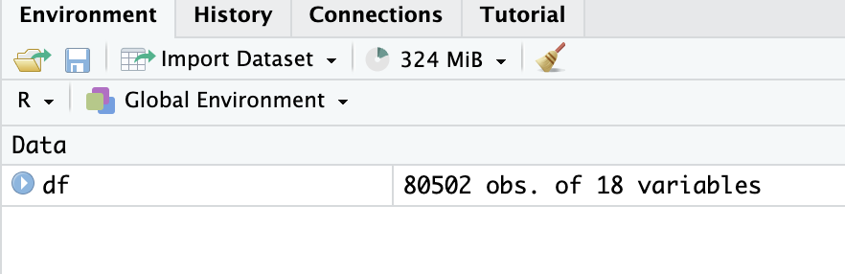
Introduction
The data for the project was taken from the Boston government Website. The Boston Police Department (BPD) introduced a new system for reporting crime incidents in June 2015, completely changing how criminal activity is recorded in the city.
This Dataset contains the following:
Observations: 80502
variables. : 18
The link for the dataset is this given here URL

Slide 3
Dataset
Here's a brief description of each variable:
X_id: This appears to be an identifier column, possibly indexing each record in the dataset. INCIDENT_NUMBER: A unique identifier assigned to each reported crime incident. OFFENSE_CODE: A numerical code that represents the specific type of offense committed.
OFFENSE_CODE_GROUP: A broader grouping of offenses based on similar characteristics or types.
OFFENSE_DESCRIPTION: A textual description of the specific offense committed. DISTRICT: The policing district or area within Boston where the crime incident occurred. REPORTING_AREA: A designated area within a district where the crime incident was reported. SHOOTING: Indicates whether a shooting was involved in the crime incident (binary variable).
OCCURRED_ON_DATE: The date and time when the crime incident occurred. YEAR: The year in which the crime incident took place. MONTH: The month in which the crime incident took place. DAY_OF_WEEK: The day of the week when the crime incident occurred. HOUR: The hour of the day when the crime incident occurred. UCR_PART: The Uniform Crime Reporting (UCR) part, which categorizes offenses based on severity and other factors.
STREET: The name of the street or location where the crime incident occurred. Lat: The latitude coordinate of the crime incident location. Long: The longitude coordinate of the crime incident location. Location: The combined latitude and longitude coordinates of the crime incident.

Slide 4
Problem Statement
Develop a predictive model to analyze the likelihood of shooting incidents based on various factors including offense code, street location, reporting area, police district, and year.

Slide 5
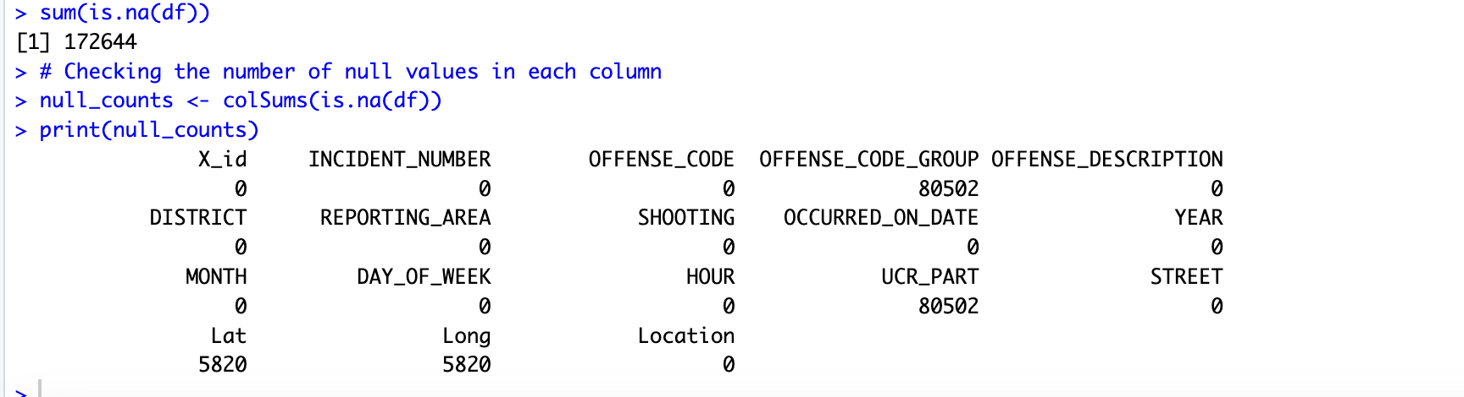
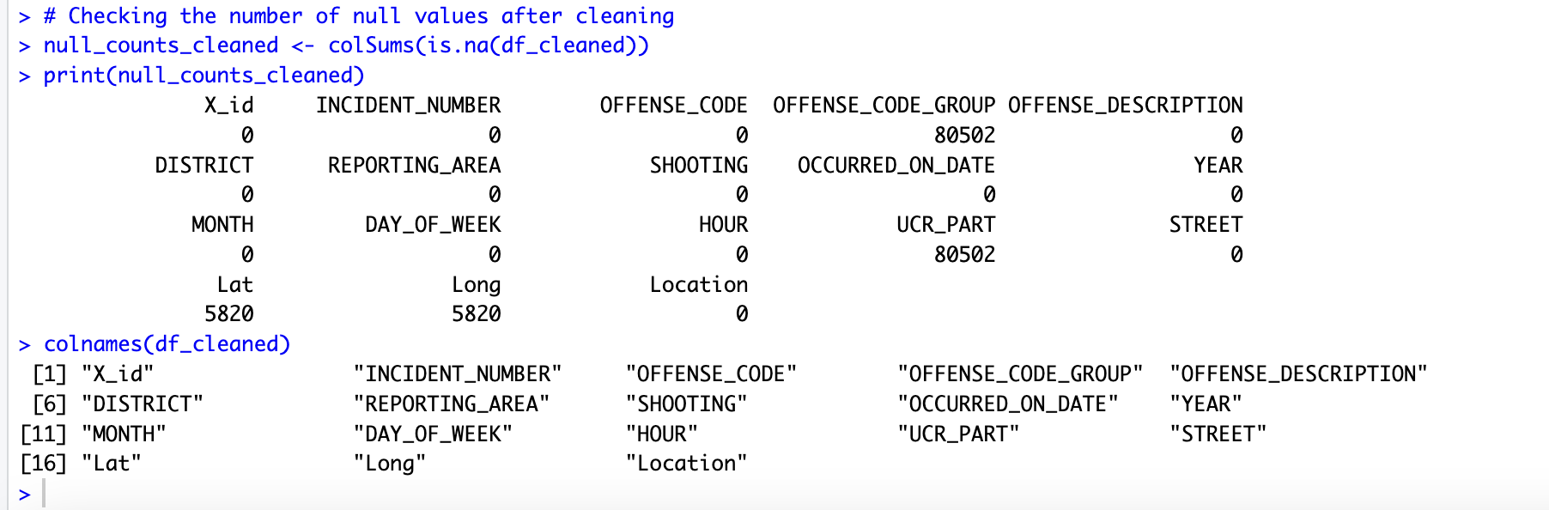
Data Cleaning
There are 80502 null values in OFFENSE_CODE_GROUP, 80502 in UCR_PART, 5820 in Lat and 5820 in Long columns.
We Replaced missing values in REPORTING_AREA column with unknown.
As Lat and Long columns are having null values so removed those rows in the dataset.
As 'OFFENSE_CODE_GROUP' and 'UCR_PART’ are having all Null values, we removed the two columns.

Slide 6
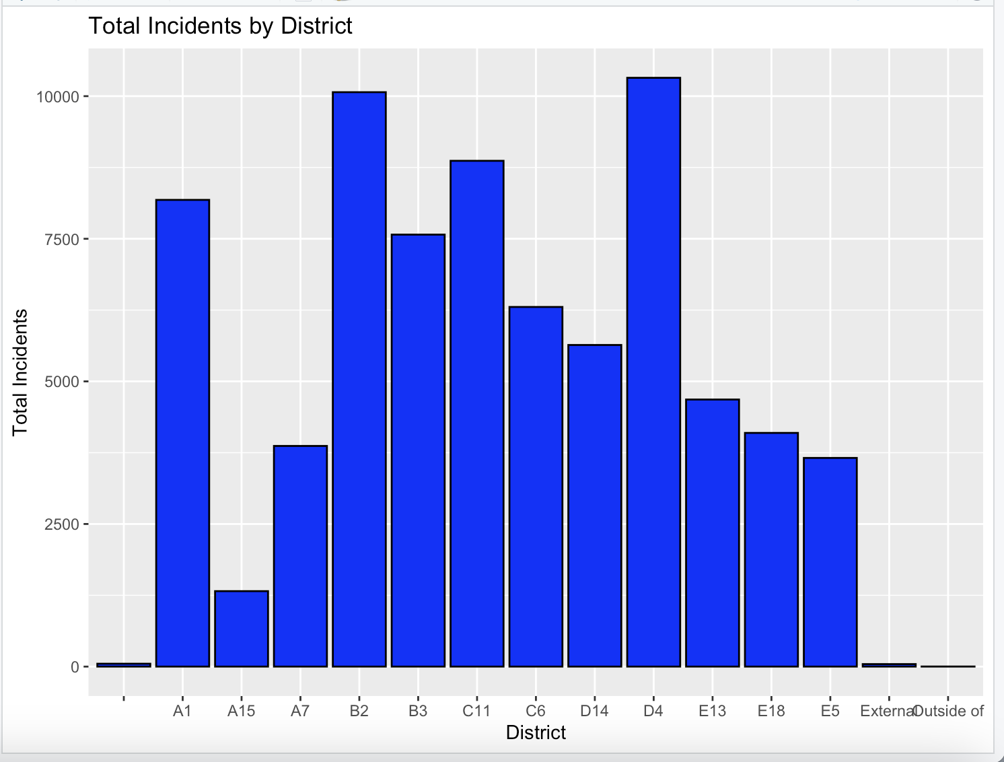
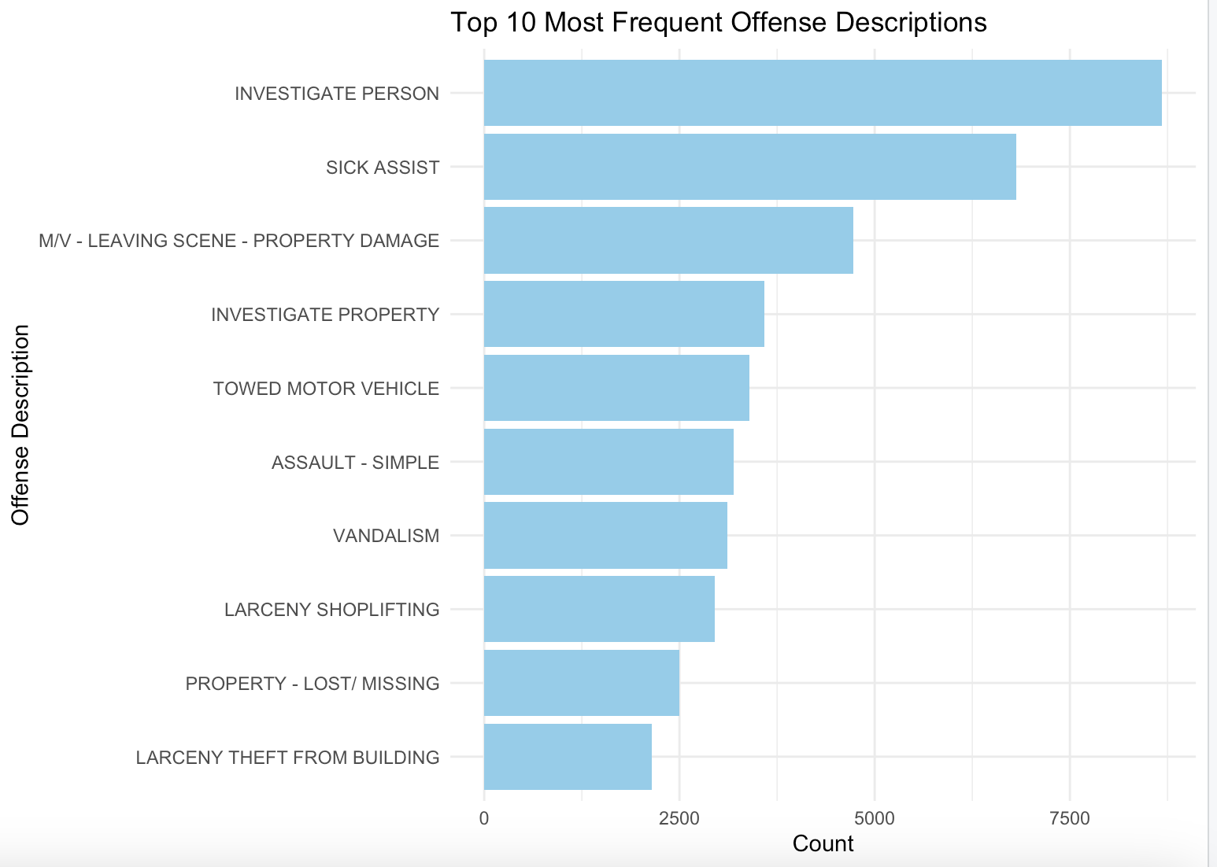
Bar Plots
Shooting incidents by district :
The total number of incidents reported in each district is plotted. Every bar signifies a district, and the height of the bar corresponds to the number of incidents. The highest number of incidents were taken place in D4 district.
Most Frequent Offense descriptions :
The top ten most common offense descriptions found in the dataset are displayed in this plot. The most frequent offenses are at the top of the list, which is arranged according to how frequently they occur.

Slide 7
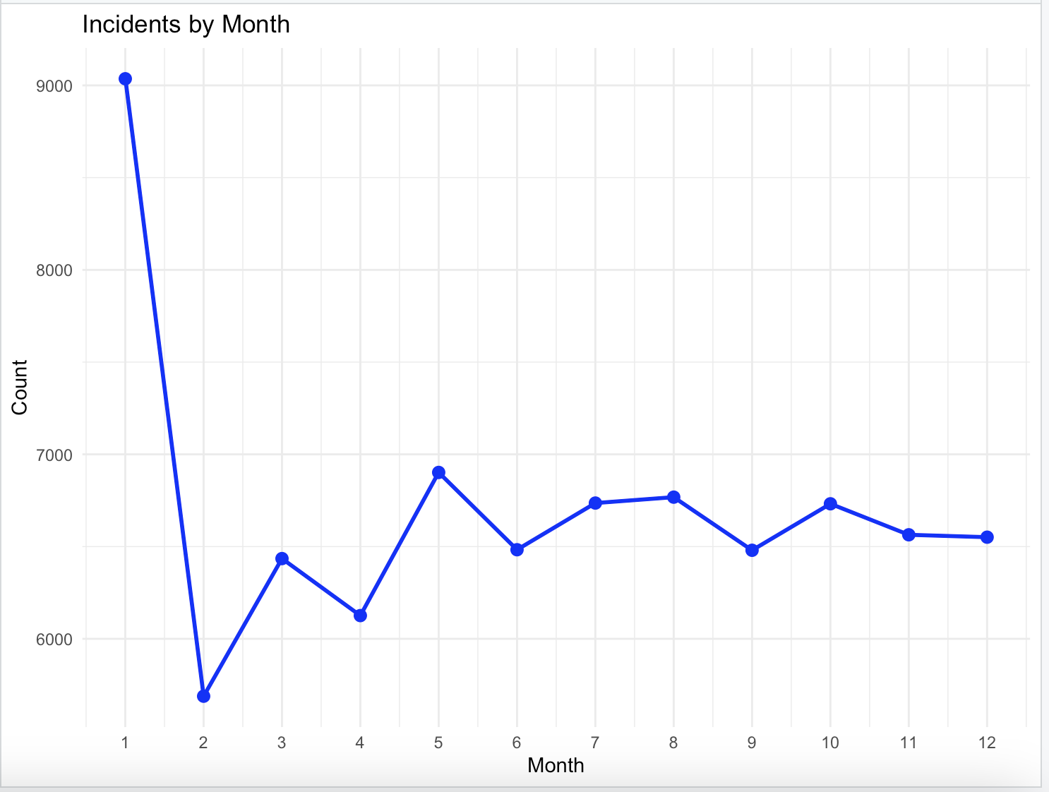
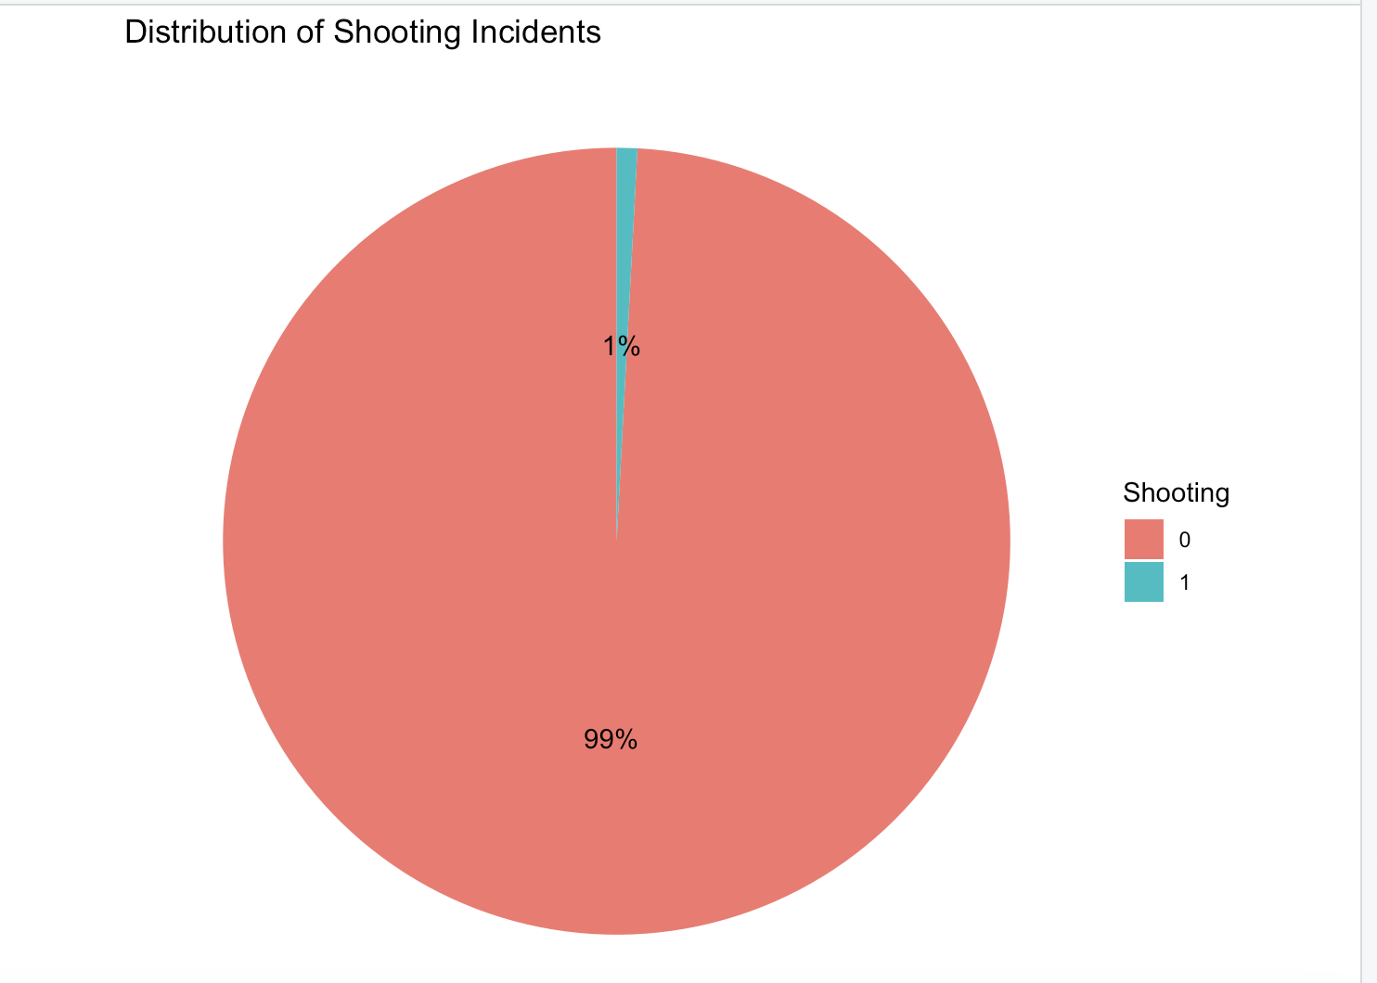
Other visualizations
Shooting incidents over time:
From the line plot of shooting incidents over time, Every data point on the plot indicates how many incidents there were in given month. The blue line that connects the blue points to represent the trend or pattern of incidents over the months shows the individual months as blue points.
Pie chart for the SHOOTING column:
From the displayed pie chart, Each category represents whether a shooting incident occurred or not. The pie chart displays the proportion of shooting incidents relative to non-shooting incidents.

Slide 8
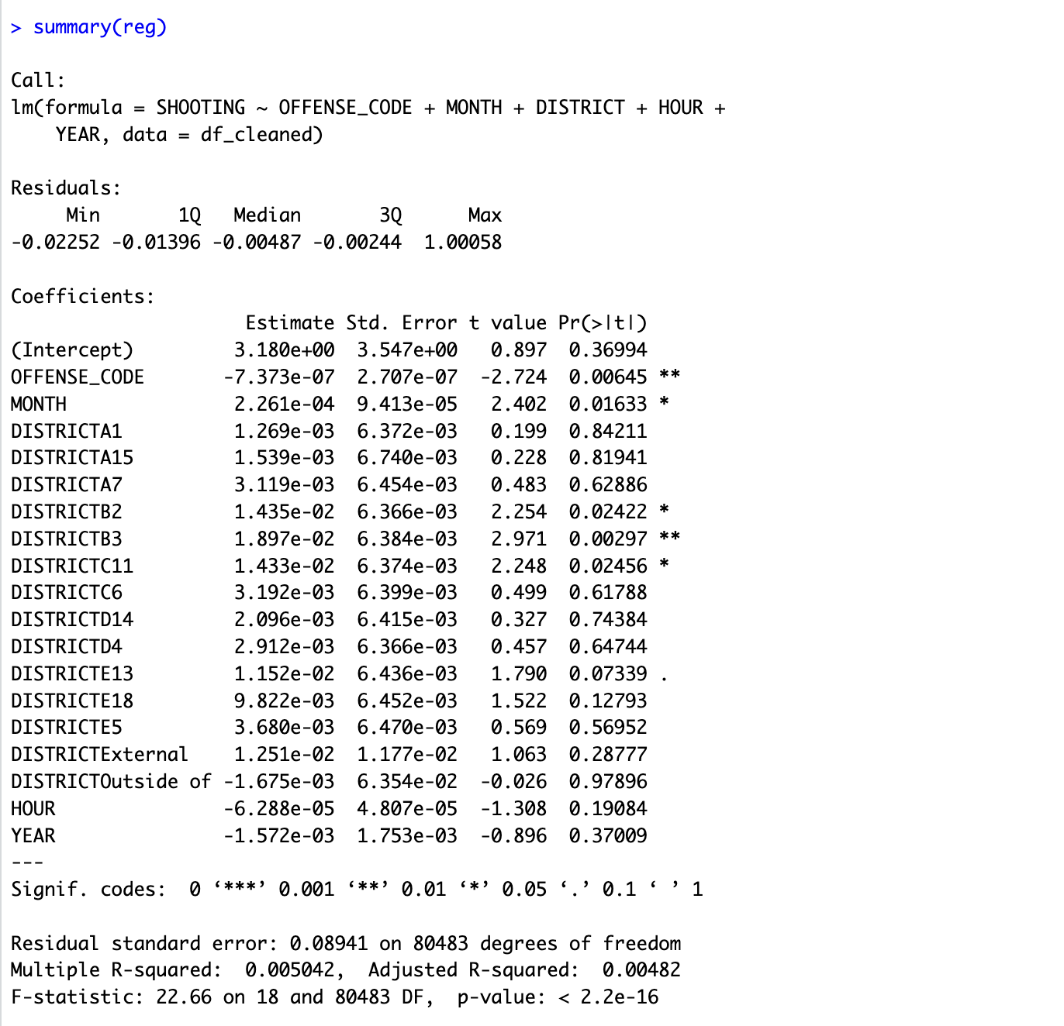
Linear Regression
Linear regression is a statistical model that analyses the relationship between a response attribute and one or more attributes and their interactions. I have performed regression using the lm function by using the shootings as response attribute and offense code, month, district, hour, and year as the other attributes as arguments.

Slide 9
Linear Regression
The above output helps us determine the effectiveness of the model
In the call section, formula for fitting the regression model is displayed where Shootings is our dependent variable and using predictor variables from the dataset.
The difference between the actual and expected values is known as the residuals. By subtracting the shootings actual values from the model's predicted values, we can produce the same values.
The residual standard error (0.09124) represents the average deviation of the observed values from the fitted regression line. A lower value indicates that the model's predictions are closer to the actual observed values. In this case, the residual standard error is relatively low, suggesting that the model provides a reasonably good fit.
Residual standard error tells us the average distance that the observed values fall from the regression line. The smaller the value, the better the regression model able to fit the data.
The Multiple R squared value ranges from 0 to 1. The closer it is to 1, the better the predictor variables able to predict the value of the response variable.
.A higher F-statistic with a low p-value suggests that the overall regression model is significant. In this case, the F-statistic is 20.94 with a p-value of < 2.2e-16, indicating that the regression model is statistically significant.

Slide 10
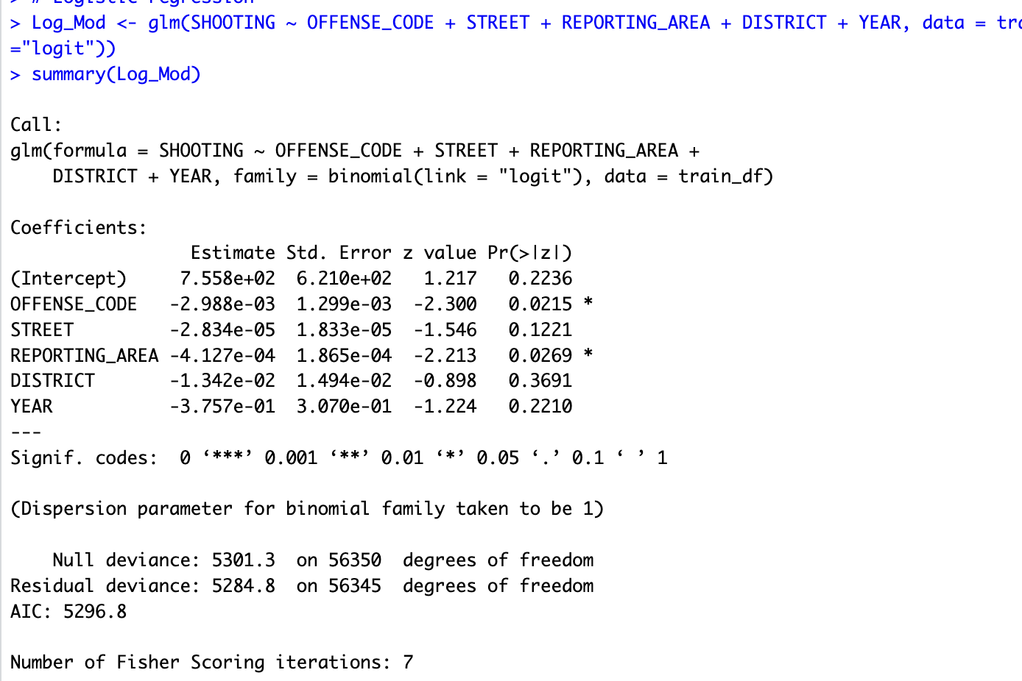
Logistic regression
Logistic Regression is basically a method that we use to fit a regression model. Logistic regression belongs to a family, named Generalized Linear Model (GLM). When there is continuous or categorical predictor variables in the data, logistic regression can be used. The glm function is used to compute logistic regression and need to give the formula, data and the family as arguments for the glm function.
We have divided the data into testing and training data, The data is split into 70-30 ratio. Where 70% for the training set and 30% for the testing set.

Slide 11
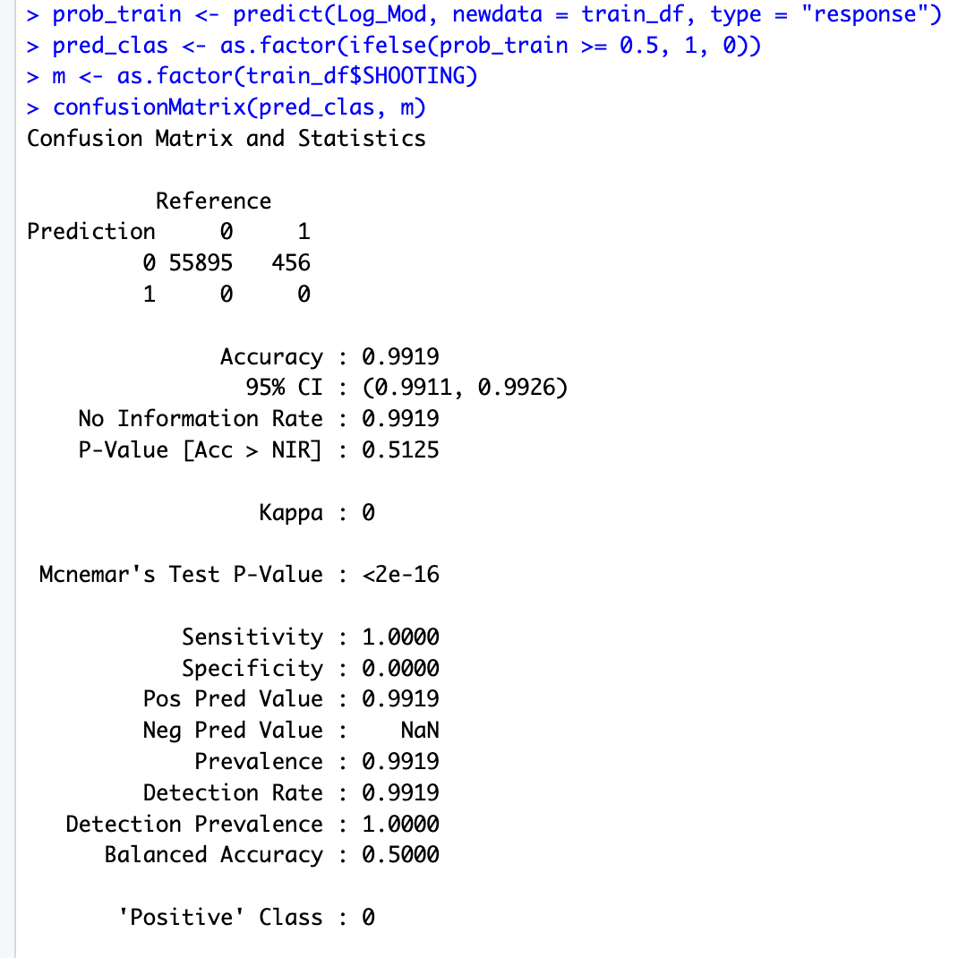
Logistic Regression
The statistic known as sensitivity measures a model's capacity to forecast true positives for Shootings. The statistic known as specificity measures a model's capacity to forecast true negatives for the shootings. Any categorical model can use these measures
Accuracy is the proportion of correct predictions over total predictions which determines the overall predicted accuracy of the model. We have an accuracy of 99.19% which means the model is very good.

Slide 12
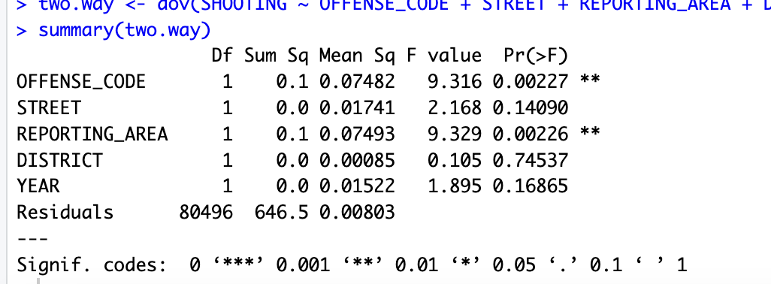
Two-way Anova
The mean of a quantitative variable is estimated using a two-way ANOVA in relation to the values of two categorical variables. When attempting to determine the combined impact of two independent factors on a dependent variable, use a two-way ANOVA.
As the p value is less than the significant value that is 0.05, we reject the null hypothesis.

Slide 13

Conclusion
We have performed Linear regression and logistic regression by taking shooting as response variable. We got 99.1% accuracy for the linear regression model which itself says that this model is best fit. The two value Anova test is performed and we have p value less than 0.05, so we reject the null hypothesis.
We can conclude that almost every model is very accurate for the Crimes dataset, but one among those models is the logistic model is the best model.
Logistic model is best as it is very easy to understand and it requires less training.

Slide 14
References
Lee, S. H. (2021, May 19). Lasso Regression Model with R code | R-bloggers. R-bloggers. https://www.r-bloggers.com/2021/05/lasso-regression-model-with-r-code/
Colors in R - department of statistics. (n.d.). Retrieved from http://www.stat.columbia.edu/~tzheng/files/Rcolor.pdf
Two-Way ANOVA Test in R - Easy Guides - Wiki - STHDA. (n.d.). http://www.sthda.com/english/wiki/two-way-anova-test-in-r
Das, S. (2022, February 6). Correlation plots in R. Medium. Retrieved from https://medium.com/@saurav12das/correlation-plots-in-r-b392056a2ce
Learn Linear Regression with R: Linear Regression In R Cheatsheet | Codecademy. (n.d.). Codecademy. https://www.codecademy.com/learn/learn-linear-regression-in-r/modules/linear-regression-in-r/cheatsheet

Slide 15
Thank You

